Slide 1
Problems in Slovakia
Education Slovakia 2020

Slide 2
Gap between rich and poor

Slide 3
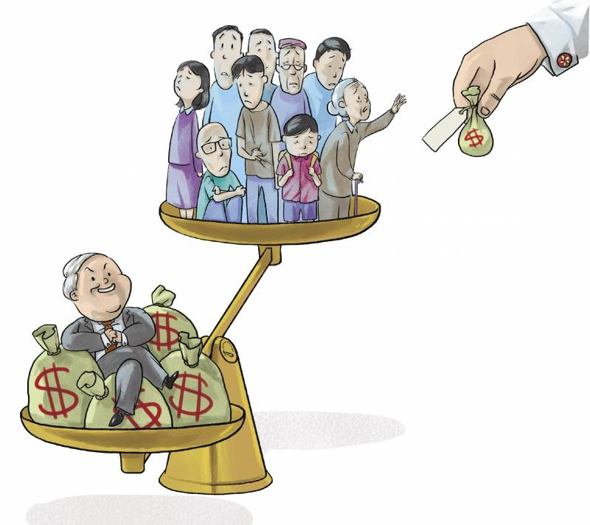

Slide 4
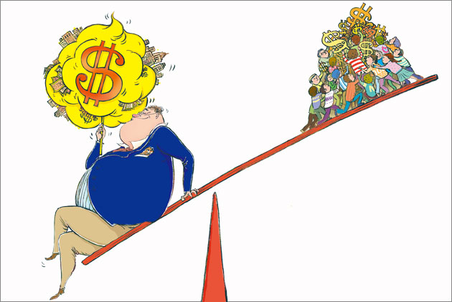
Why the gap exist?

Slide 5
How to solve it?

Slide 6
Government can open as many jobs as possible

Slide 8
1. Start with yourself first 2. Help others if you can help them

Slide 9
Gap between rich and poor is hard to solve forever When you complain about it But what you can do is make a change for yourself now, that’s the way to deal with.

